Slide 1
NSCap
@CS.NCTU
Lab7
OVS and Ryu Installation
Instructor: Kate Lin

Slide 2
Objectives
In this checkpoint, we are going to build a software-defined network(SDN) environment You’ll learn:
How to setup an environment so that controller can interact with AP based on OpenFlow protocol
How to run a Ryu program to add flow rules and monitor flow entries

Slide 3
Overview

Slide 4



Overview
Request flow statistics information periodically
Forward unknown packet and report flow state
Connect
Look up flow rule to make decision (forward / reject)

Slide 5
Open vSwitch (OVS)
OVS is one of the open-source implementation of OpenFlow protocol
https://www.openvswitch.org/
Install OVS on an OpenWrt-installed AP, so that controller can add flow rule on AP through OpenFlow protocol
Open vSwitch command
OVS manpage

Slide 6
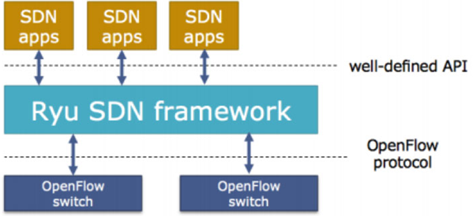
Ryu SDN
Ryu is a component-based software defined networking (SDN) framework
Support various protocols for managing network devices, such as OpenFlow, etc.
Write event-handler to deal with packet-in from AP
Reference: https://www.sdxcentral.com/networking/sdn/definitions/what-is-ryu-controller/

Slide 7
Tasks

Slide 8
Tasks
Create a VM as SDN controller and install Ryu
Modify network settings on router to create new subnet and VLAN for controller
Configure OVS on router
Configure network settings on controller
Modify simple_switch_13.py on controller

Slide 9
Before We Start
🚨
OpenWrt uses a daemon named “hostapd” which is provided by “wpad-basic” package to authenticate WiFi password.
However, this package doesn’t support OVS, if we set a WiFi password and use OVS as LAN bridge, the handshake between UE and WiFi will failed.
Solution: Install new wpad-basic modified by TA
wpad-basic_2019-08-08-ca8c2bd2-8_mipsel_24kc.ipk

Slide 10
Task 1. Setup Controller
Use the VM in Lab5 with Ubuntu Desktop 20.04 on your PC
Install Ryu
# sudo apt update
# sudo apt install python3-ryu

Slide 11
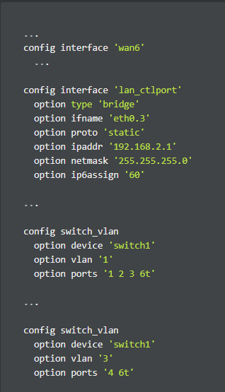
Task 2: Modify Network Settings on Router
Connect your PC to router through WiFi first
In case we lose connection during we reset AP's port that is connecting to controller
To separate controller from other users,
we need to create a new subnet (192.168.2.x)
for controller
# ssh root@192.168.1.1
Modify network setting to add a new bridge
interface and include VLAN for Port 4
# vim /etc/config/network

Slide 12
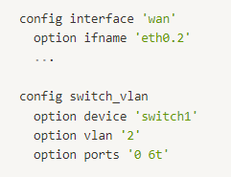
Task 2: Modify Network Settings on Router
Some Notices
ifname 'eth0.{num}' = vlan '{num}’
port 0: WAN
port 1: LAN 1 (label as 4 on router)
port 2: LAN 2 (label as 3 on router)
port 3: LAN 3 (label as 2 on router)
port 4: LAN 4 (label as 1 on router) (connected to controller)

Slide 13
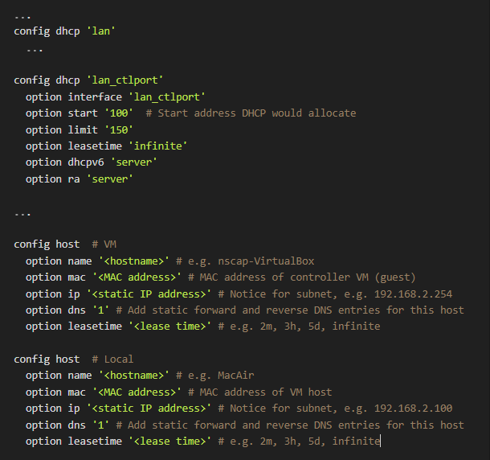
Task 2: Modify Network Settings on Router
Modify DHCP setting
# vim /etc/config/dhcp
Set by yourself

Slide 14
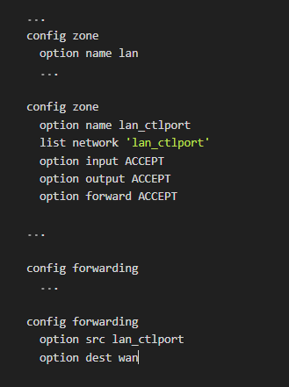
Task 2: Modify Network Settings on Router
Modify firewall setting to enable forwarding for the new bridge interface on Port 4
# vim /etc/config/firewall

Slide 15
Task 2: Modify Network Settings on Router
Restart network, DHCP server and firewall service to apply our changes
Note that your WiFi might be disconnected for a while
# /etc/init.d/network restart
# /etc/init.d/dnsmasq restart
# /etc/init.d/firewall restart
Disconnect controller from AP
Connect your PC to Port 4 through Ethernet wire

Slide 16
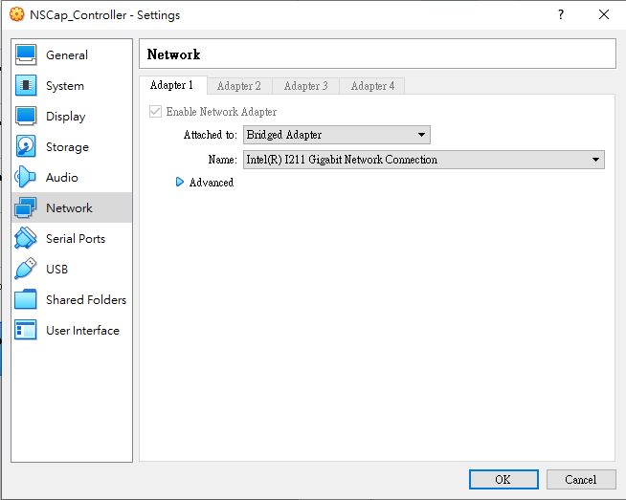
Task 2: Modify Network Settings on Router
Set network adapter#1 to Bridged Adaptor in VM network Setting
On your PC, use following command to login router:
# ssh root@192.168.2.1

Slide 17
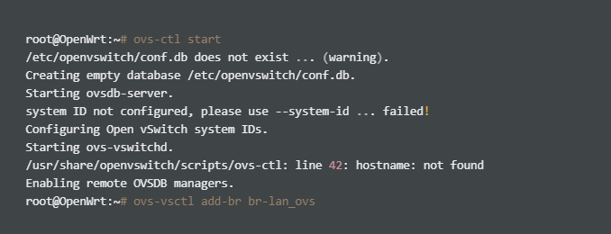
Task 3. Configure OVS on Router
Start OVS service and create OVS bridge
# ovs-ctl start
# ovs-vsctl add-br br-lan_ovs

Slide 18
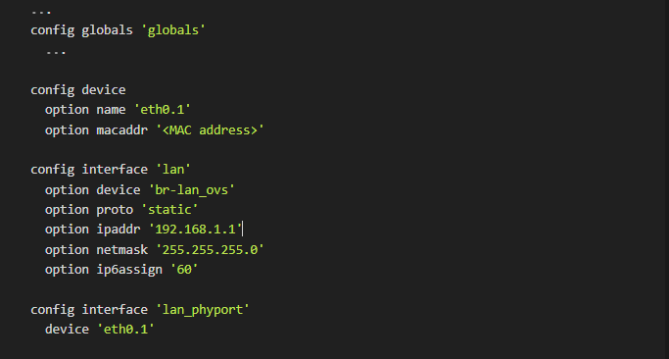
Task 3. Configure OVS on Router
Delete default bridge br-lan and use br-lan_ovs as LAN interface by modifying network setting
# vim /etc/config/network
# Same as your br-lan_ctlport's MAC address, you can find it via "ip a" command
# Change ifname to <br-name>, e.g. br-lan_ovs
# Add new interface that defined eth0.1, otherwise OpenWrt can't find eth0.1 option

Slide 19
Task 3. Configure OVS on Router
Restart network service
# /etc/init.d/network restart
Add LAN/WLAN interfaces to OVS bridge and set controller
# ovs-vsctl add-port br-lan_ovs eth0.1
# ovs-vsctl add-port br-lan_ovs wlan0
# ovs-vsctl add-port br-lan_ovs wlan1
# ovs-vsctl set-controller br-lan_ovs tcp:192.168.2.254
# ovs-vsctl show

Slide 20
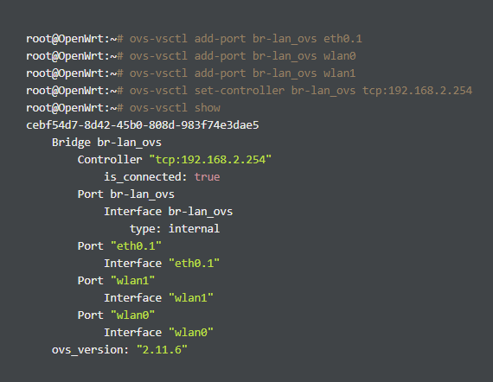
Task 3. Configure OVS on Router
Check your OVS setting
# ovs-vsctl show

Slide 21
Task 4. Ryu Controller
Ryu controller:
# ryu-manager [--verbose] [--observe-links]
=> Show some links and debug information
# ryu-manager ryu.app.ofctl_rest
=> Retrieving and updating the switch stats
# ryu-manager ryu.app.simple_switch_13
Monitor flow entries:
OFPPortStatsRequest
Query flow statistics
OFPFlowStatsRequest
Query port statistics

Slide 22
Task 4. Ryu Controller
Add flow rules
“self.add_flow(datapath, priority, match, actions)”
“Datapath” represents which switch you want to send the message
“Priority” is the flows priority, the higher number means the higher priority
For the match and action field, you can refer to the following two links
http://ryu.readthedocs.org/en/latest/ofproto_v1_3_ref.html#flow-match-structure
http://ryu.readthedocs.org/en/latest/ofproto_v1_3_ref.html#action-structures
Hints
If you want to match the packet using
ipv4_src="x.x.x.x“ or ipv4_dst="x.x.x.x“, then you have to add one more matching rule of “eth_type=0x0800”

Slide 23
Task 4. Ryu Controller
Connect your router to Internet via WAN
Use another device to connect to the Wifi
Try # ping 8.8.8.8
You may ping successfully at this time even there’s no controller, Since the default action of OVS is to forward the packet

Slide 24
Task 4. Ryu Controller
[TODO]
Copy the code of “simple_switch_13.py”
https://github.com/faucetsdn/ryu/blob/master/ryu/app/simple_switch_13.py
Use the hint we give you in p22, to drop packets that are destined to 8.8.8.8
After that, when running Ryu controller in VM(not in router)
# Ryu-manager <file_name>
You should not be able to ping 8.8.8.8 successful
In 192.168.1.1
You still can ping another IP address(e.g. 1.1.1.1)

Slide 25
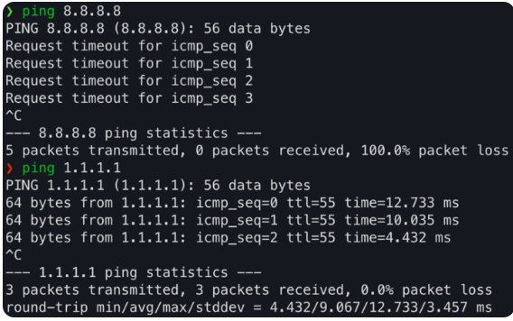
Task 4. Ryu Controller

Slide 26
Task 4. Ryu Controller
Check flow rules installed on the specific bridge
# ovs-ofctl dump-flows <bridge>
Delete all flow rules on the specific bridge
# ovs-ofctl del-flows <bridge>
After executing ping command, you should get the result like below
Drop rule

Slide 27
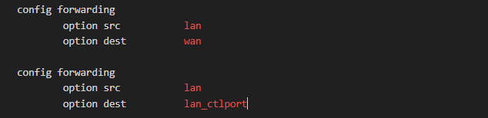
Task 4. Ryu Controller
If you don’t have any available network socket
Modify /etc/config/firewall
# ping 192.168.2.254 , following the procedure above
You should get the similar result
You can ping 192.168.2.1 to check whether you do correct or not

Slide 28
Submission
Upload your files to E3
Report : lab7_report_(yourID).pdf
Code : simple_switch_(yourID).py
Report should include 1. The screenshot of your network setting
(In p11-14, p18 and p20)
2. The screenshot of the command
“ovs-ofctl dump-flows <bridge>”
after running Ryu controller
3. Detailed description of implementation,
especially in task 4, e.g. devices used, ping method,
connection of your cable, how to drop packets…

Slide 29
Grading Policy
Deadline – 2022.06.05 23:59 (by Sunday night)
Grade
Report - 80%
Code-20%
Late Policy
(Your score ) * 0.8^{D}, where D is the number of days over due
Cheating Policy
Academic integrity: Homework must be your own – cheaters share the score
Both the cheaters and the students who aided the cheater equally share the score

Slide 30
Reference
OVS installation:
https://openwrt-nctu.gitbook.io/project/experiment-sdn/ovs-on-openwrt
ovs-ofctl:
http://www.openvswitch.org/support/dist-docs/ovs-ofctl.8.txt
Ryu API reference:
https://ryu.readthedocs.io/en/latest/api_ref.html
Ryu application example:
https://sites.google.com/site/sdnruantidingyiwanglu/xing-dong-kuan-pin-jian-duan-ji-shu-tui-guang-ji-hua/jian-yi-wang-lu-ce-liang
OpenFlow switch specification:
https://opennetworking.org/wp-content/uploads/2014/10/openflow-switch-v1.5.1.pdf

